Slide 1


Services and Solutions Streamlined (S3)
Version 1.0 Release
(One Stop Solution for Property / Facility Management Services)
By - Team

Slide 2
ToC
Agenda
Schedule
1st Day
2nd Day
Landing Page (Mobile
Screens – Signature,Password,home page,Resident management,staff management,Visitor Management,attendance management,Service,Invoice, Pet Management,Notice,slide show,
Plan for future

Slide 3
Plan for the Day
Day 1 – 21/7
Opening Session – 12 pm introduction and SPOC allocation from Azea.
Going through ppt – 2 pm – 5 pm (Presenting the PPT with of Web & Mobile App
Quarry clarification – after 5 PM
Day 2 – 22/7
Dummy Data entry using Web for all implemented feature(10 users)- 10 am 11 am
Training session on Mobile & Web Version(11 am To 12.30 pm)
Demonstration for all features on Mobile and Web app

Slide 4
Requirement Analysis – Feature Bucketing
Phasing of Web Based Implementation
Phasing of Mobile App Based Implementation
Phase of Exe | S# | Module | Complexity | Mode
Phase 1 | 1 | User Management | MEDIUM | web
 | 2 | Staff Management | MEDIUM | web
 | 3 | Visitor Management | MEDIUM | web
 | 4 | Raise Invoices for various society charges | HIGH | web
 | 5 | Report | HIGH | web
 |  | R&M Services (Paid)
 | 6 | Complaints, Suggestions & Feedback | MEDIUM | web
 | 7 | Notifications, Bulk upload & Announcement | MEDIUM | web
Phase 2 | 8 | Communication management | HIGH | web
 | 9 | Daily staff management (Residents hired staff) | MEDIUM | web
 | 10 | Child security management | MEDIUM | web
 | 11 | Amenities booking | HIGH | web
 | 12 | Helpdesk/Complaints Management | HIGH | web
 | 13 | Multi property management | HIGH | web
 | 14 | Stock and inventory management | MEDIUM | web
Phase 3 | 15 | Contract & compliance management | HIGH | web
 | 16 | Work Order Management | HIGH | web
 | 17 | SLA, Reminder & Escalations | LOW | web
 | 18 | Asset Management | MEDIUM | web
 | 19 | In-house & third party application accessibility | HIGH | web
 | 20 | Health, Safety & Trainings | HIGH | web
Phase 4 | 21 | Mobility | HIGH | web
 | 22 | Buy, Sell & Rent | MEDIUM | web
 | 23 | Socializing | MEDIUM | web
 | 24 | Recruitments | MEDIUM | web
 | 25 | Stand alone service provider | MEDIUM | web
Phase of Exe | S# | Module | Complexity | Mode
Phase 5 | 1 | User Management | MEDIUM | MOBILE
 | 2 | Staff Management | MEDIUM | MOBILE
 | 3 | Visitor Management | MEDIUM | MOBILE
 | 4 | Raise Invoices for various societycharges | HIGH | MOBILE
 | 5 | Report | HIGH | MOBILE
 | 6 | Stock and inventory management | MEDIUM | MOBILE
 | 7 | Asset Management | MEDIUM | MOBILE
 | 8 | Communication management | HIGH | MOBILE
 | 9 | Daily staff management (Residents hired staff) | MEDIUM | MOBILE
 | 10 | Child security management | MEDIUM | MOBILE
 | 11 | Amenities booking | HIGH | MOBILE
 | 12 | Helpdesk/Complaints Management | HIGH | MOBILE
 | 13 | Multi property management | HIGH | MOBILE
 | 14 | Suggestions & Feedback | MEDIUM | MOBILE
Phase 6 | 15 | Contract & Compliance management | HIGH | MOBILE
 | 16 | Work Order Management | HIGH | MOBILE
 | 17 | SLA, Reminder & Escalations | LOW | MOBILE
 | 18 | Notifications & Bulk upload | MEDIUM | MOBILE
 | 19 | In-house & third party application accessibility | HIGH | MOBILE
 | 20 | Health, Safety & Trainings | HIGH | MOBILE
 | 21 | Mobility | HIGH | MOBILE
 | 22 | Buy, Sell & Rent | MEDIUM | MOBILE
 | 23 | Socializing | MEDIUM | MOBILE
 | 24 | Recruitments | MEDIUM | MOBILE
 | 25 | Stand alone service provider | MEDIUM | MOBILE

Slide 5
Milestones & Current Status
S# | Milestone Name | Initial Plan | Revised Plan | Comments
1 | M0 (WK0) | Proposal Submission & Team in Place | Proposal Submission & Team in Place | done
2 | M1 (WK10) | MVP & Phase 1 Features | MVP & Phase 1 Features | Done (web version)
3 | M2 (WK14) | Phase 2 | Phase 5 | Done Phase 5 mobile version
4 | M3 (WK18) | Phase 3 | Phase 2 & Phase 6 | In Progress 40%
5 | M4 (WK20) | Phase 4 | Phase 3 & Phase 6 | In Progress
6 | M5 (WK24) | Phase 5 | Phase 4 & Phase 6 | In Progress
7 | M6 (WK28) | Phase 6

Slide 6
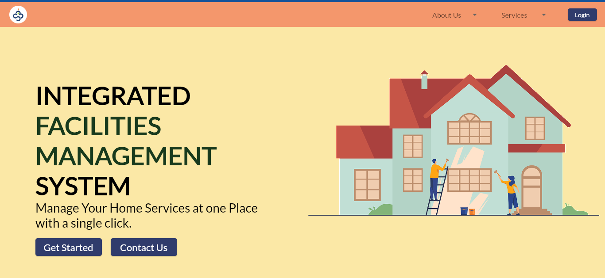
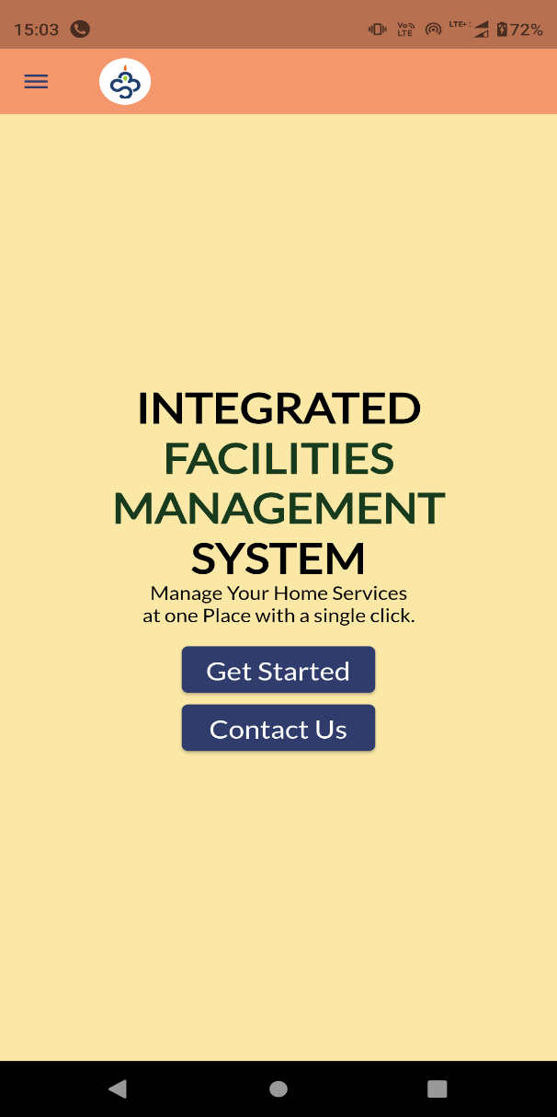
Landing Page

Slide 7
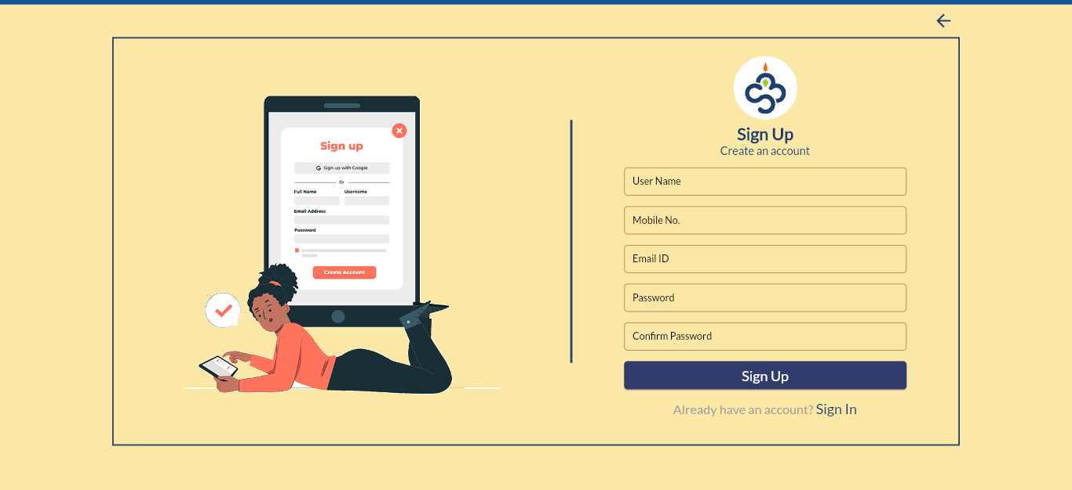
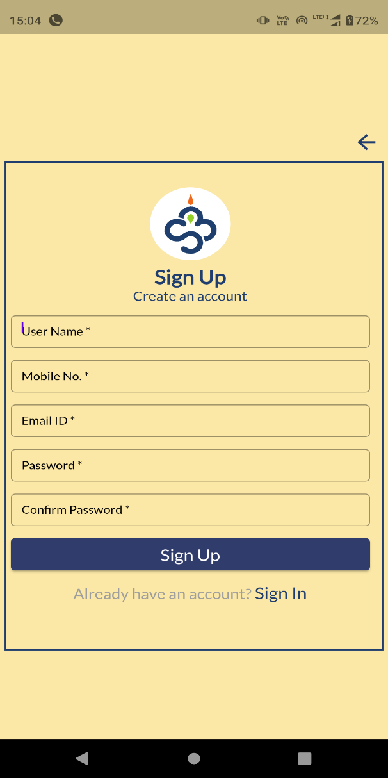
Sign Up

Slide 8
Sign Up
A new user can create account using sign-up option. Any user with valid email id can be register in application.
Every newly signed in user will be considered as resident/normal user with limited access.
A predefined admin user can change the user type to security, office admin like that.

Slide 9
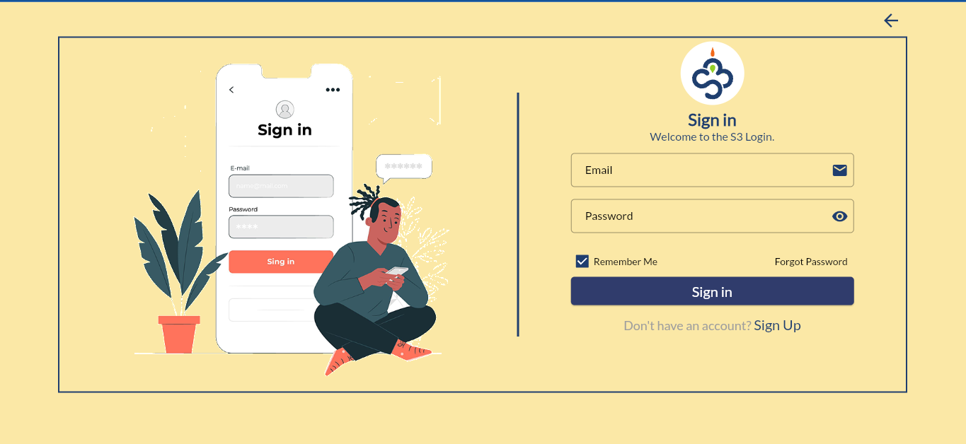
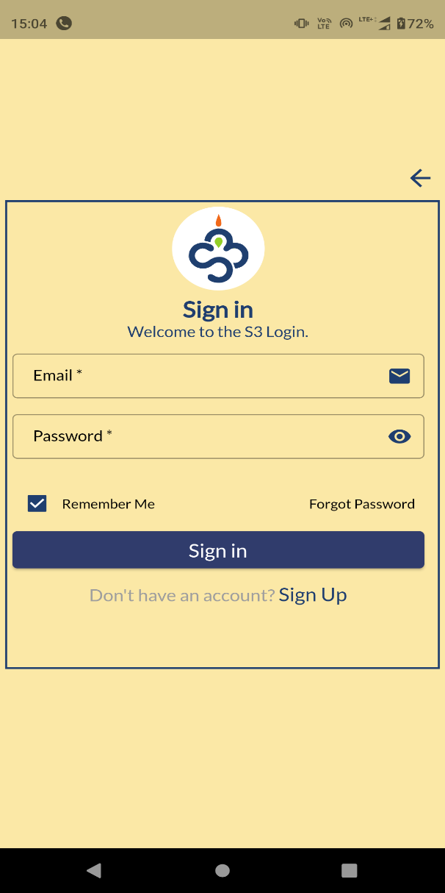
Sign In

Slide 10
Sign In
A registered user can sign-in with credentials.

Slide 11
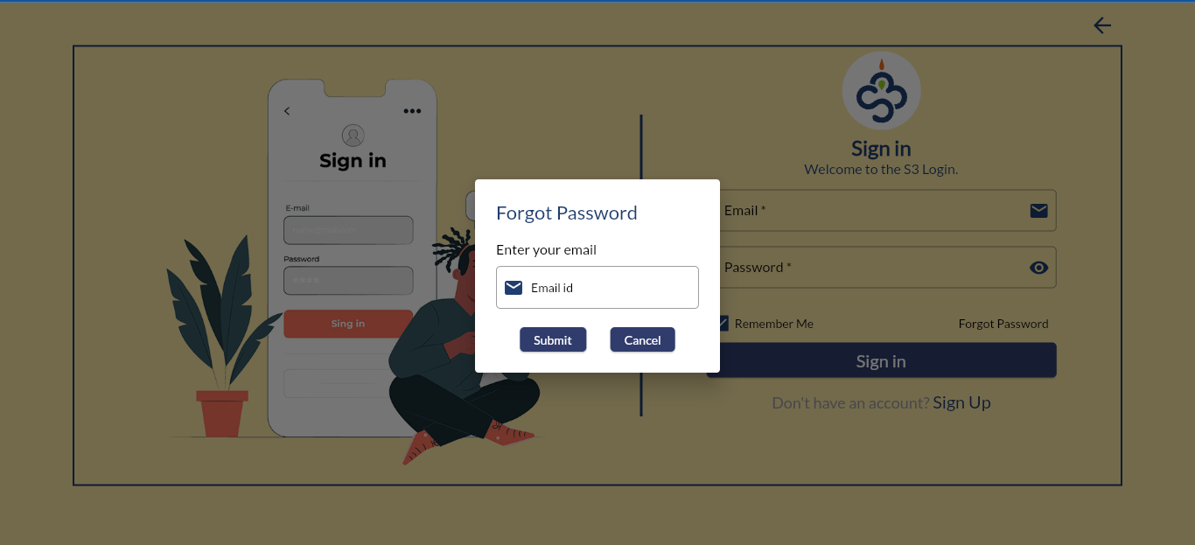
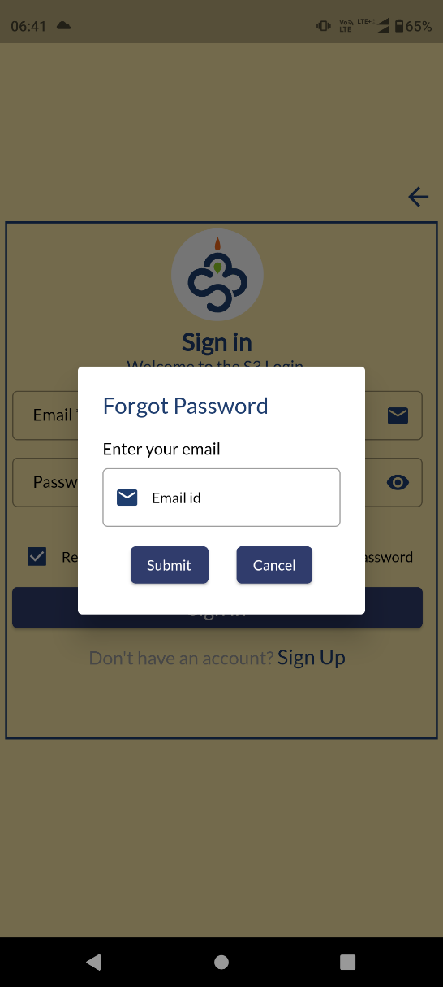
Forget Password

Slide 12
Forgot Password
Forgot password option provides user, a facility to reset the password.
User will get an reset link in the registered email id.

Slide 13
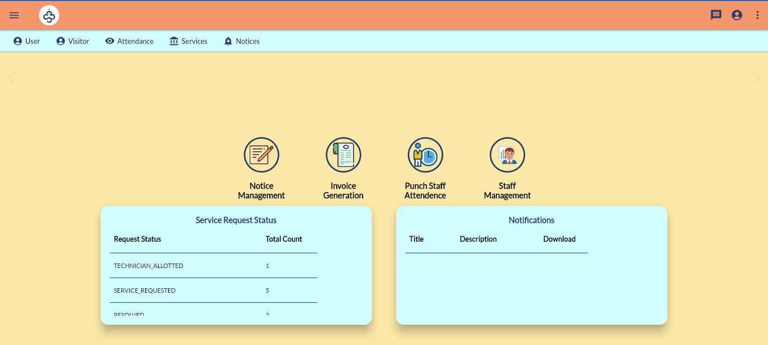
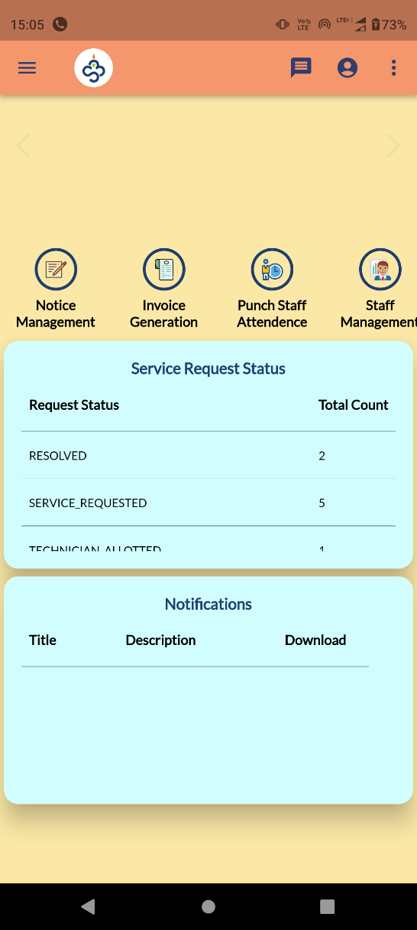
Home Page

Slide 14
Home Page
Home page menu will vary as per the user type.

Slide 15
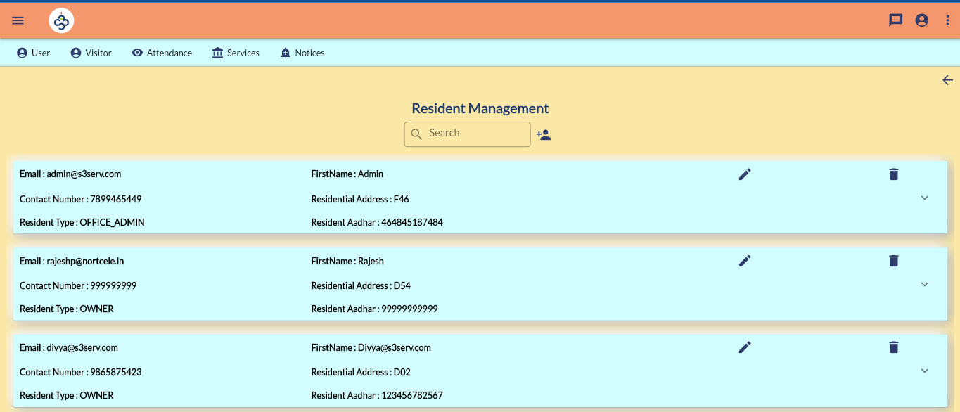
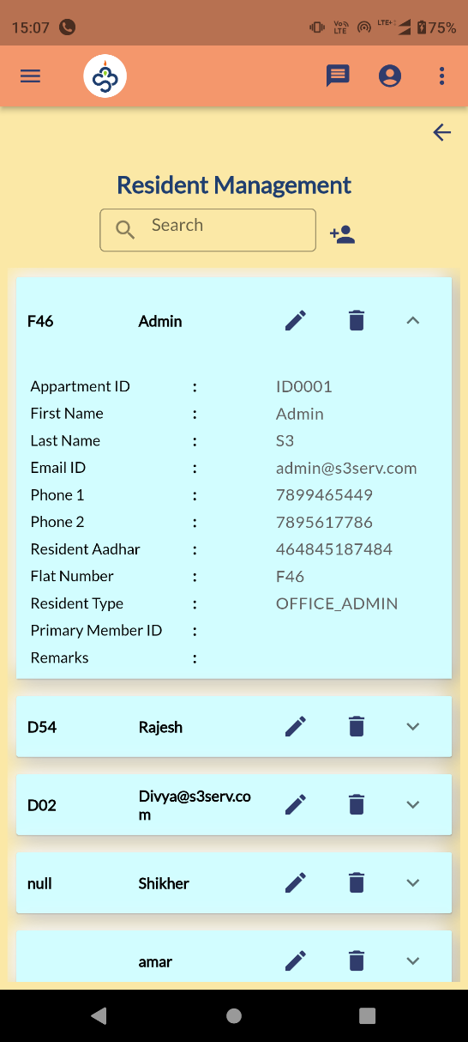
Resident Management

Slide 16
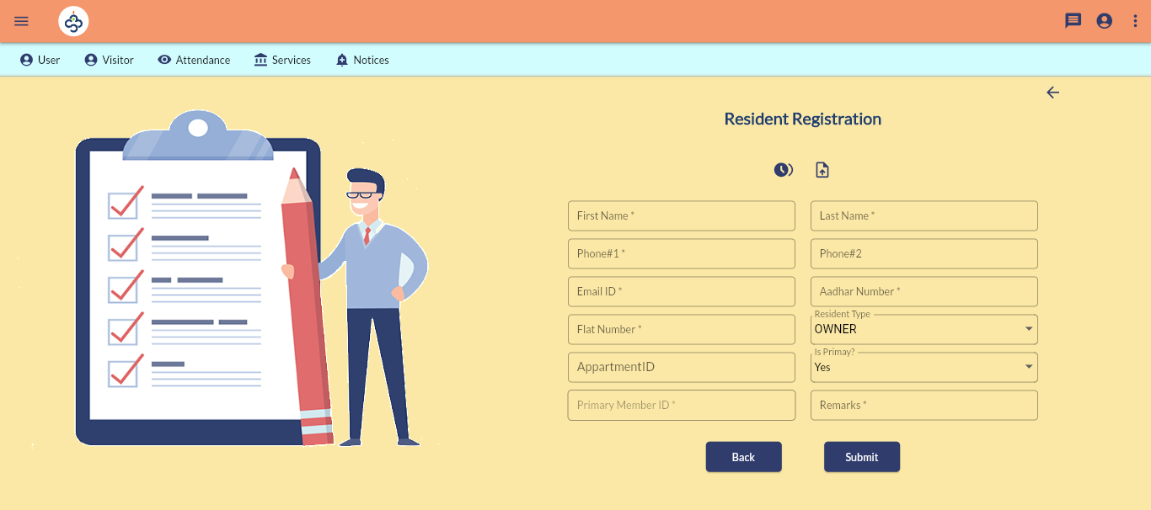
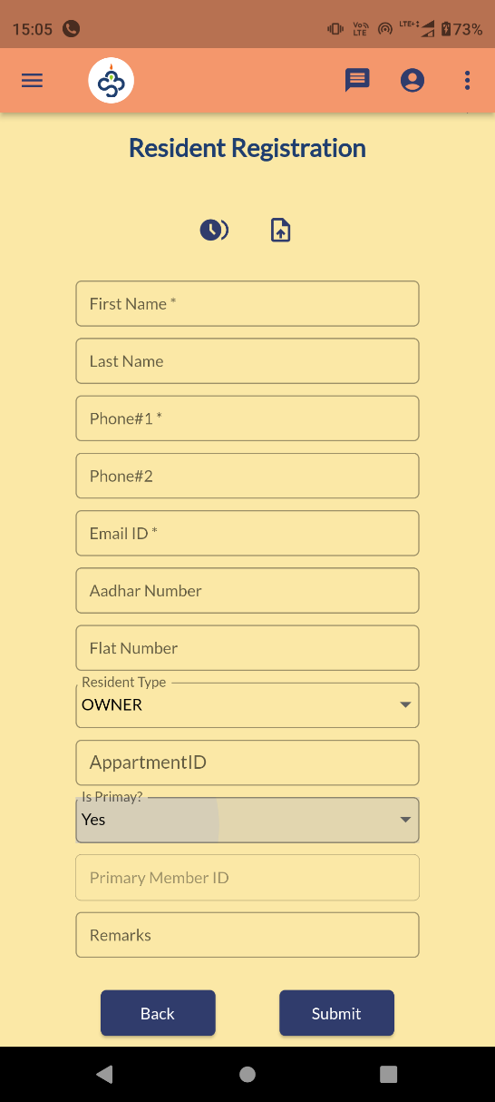
Resident Registration

Slide 17
Resident Management
User >>Resident Management
An admin user can see and edit all registered users.

Slide 18
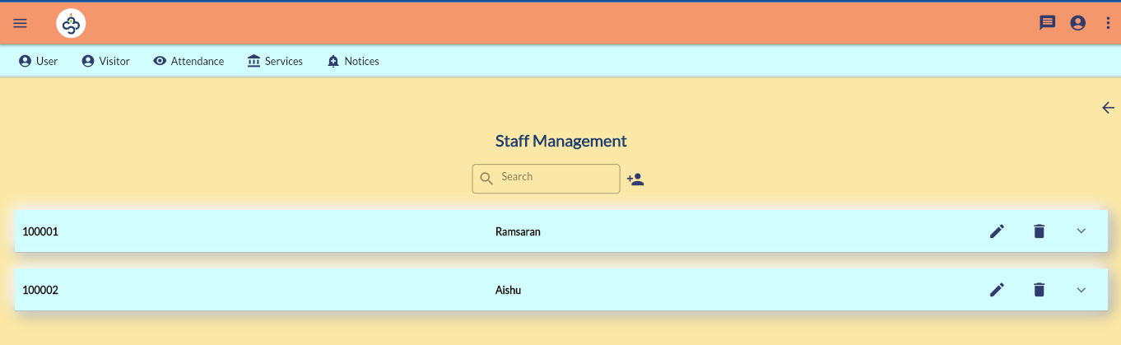
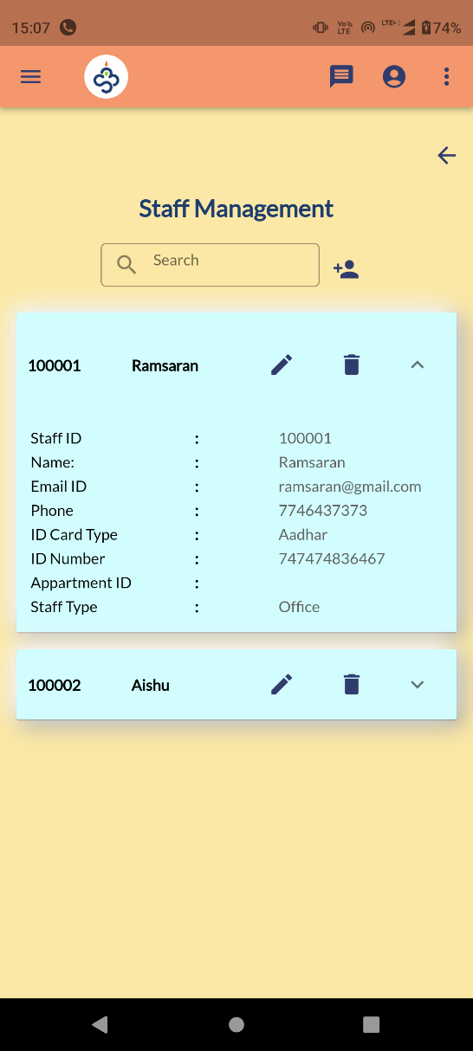
Staff Management

Slide 19
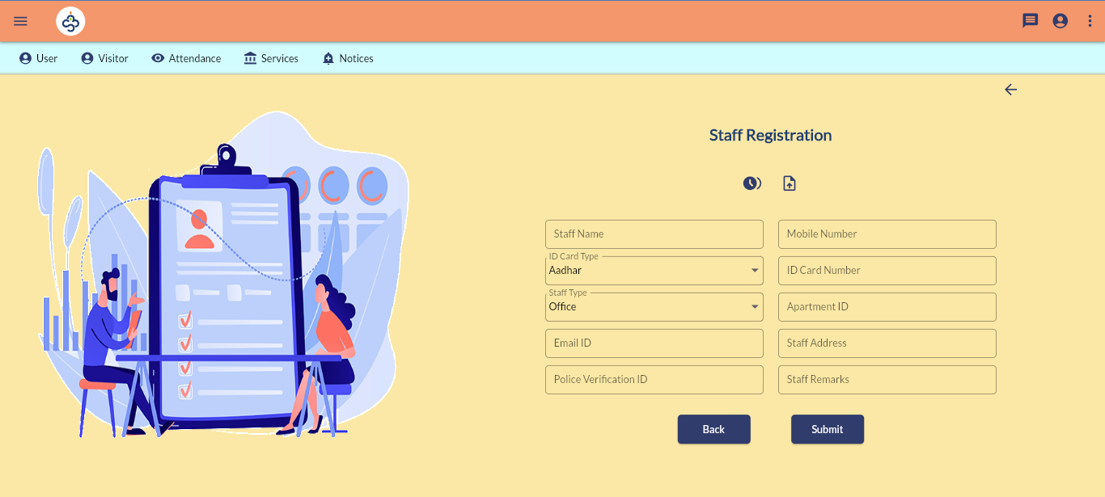
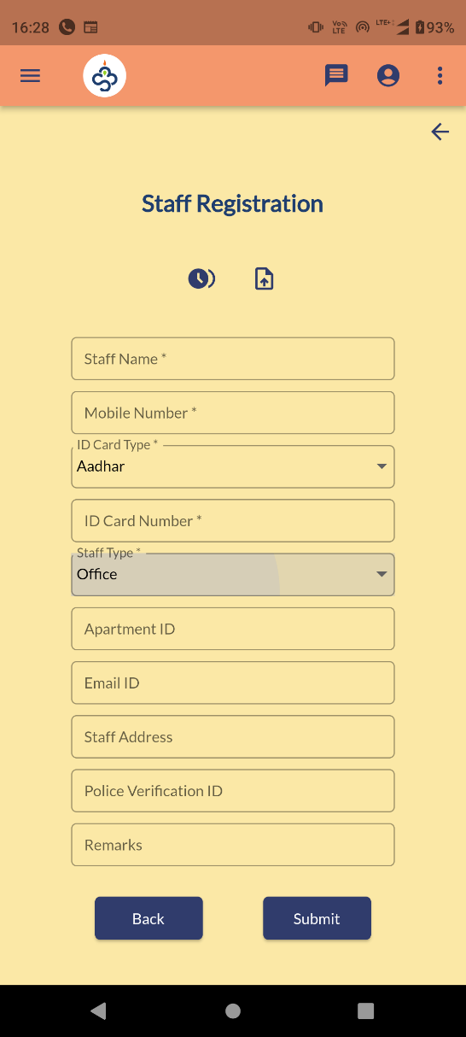
Staff Registration

Slide 20
Staff Management
User >> Staff Management
Currently this menu will act as register for staffs related to office/maids.

Slide 21
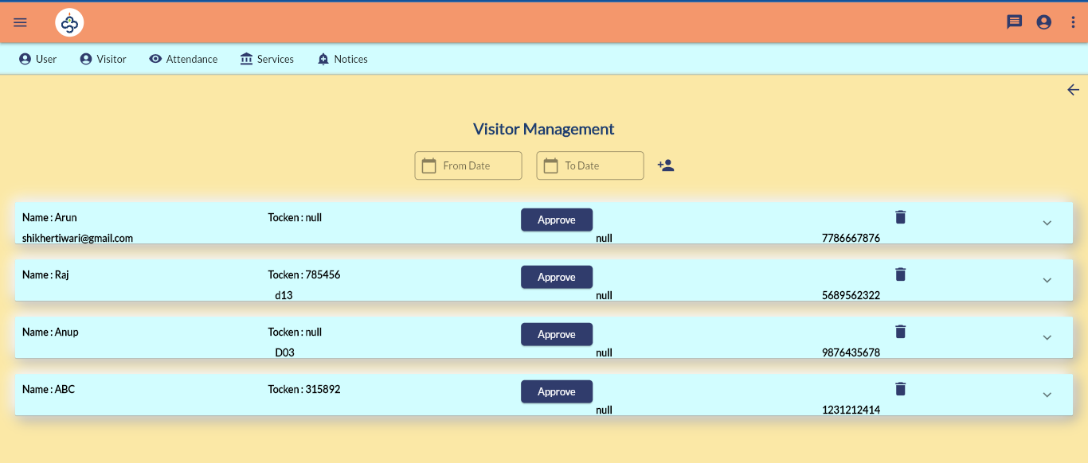
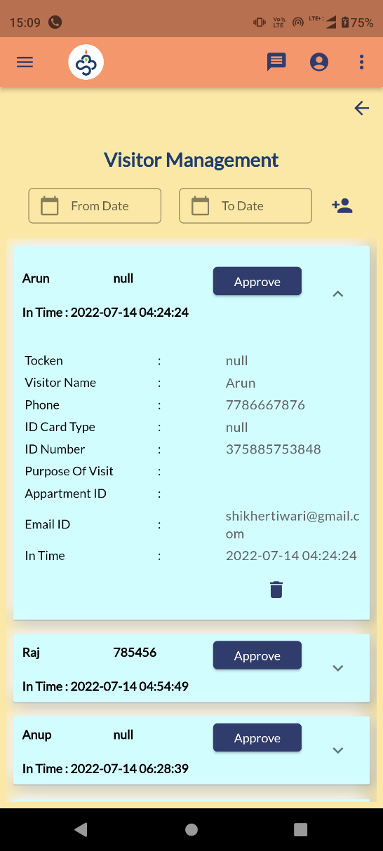
Visitor Management

Slide 22
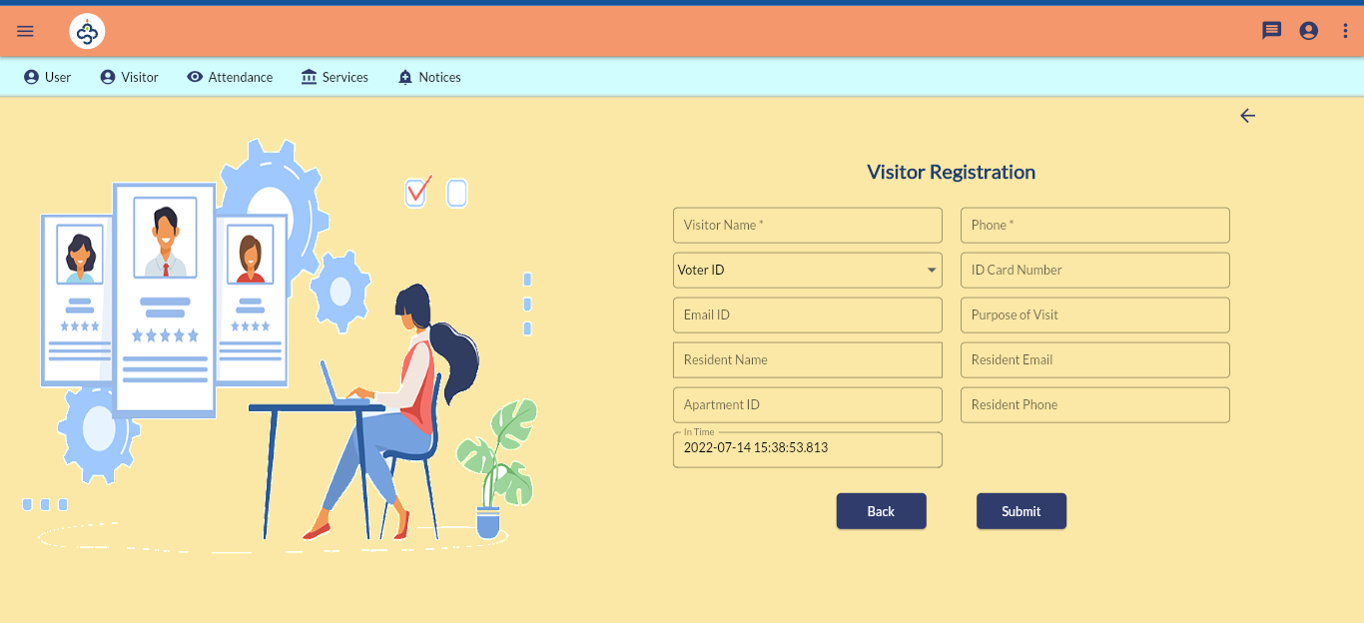
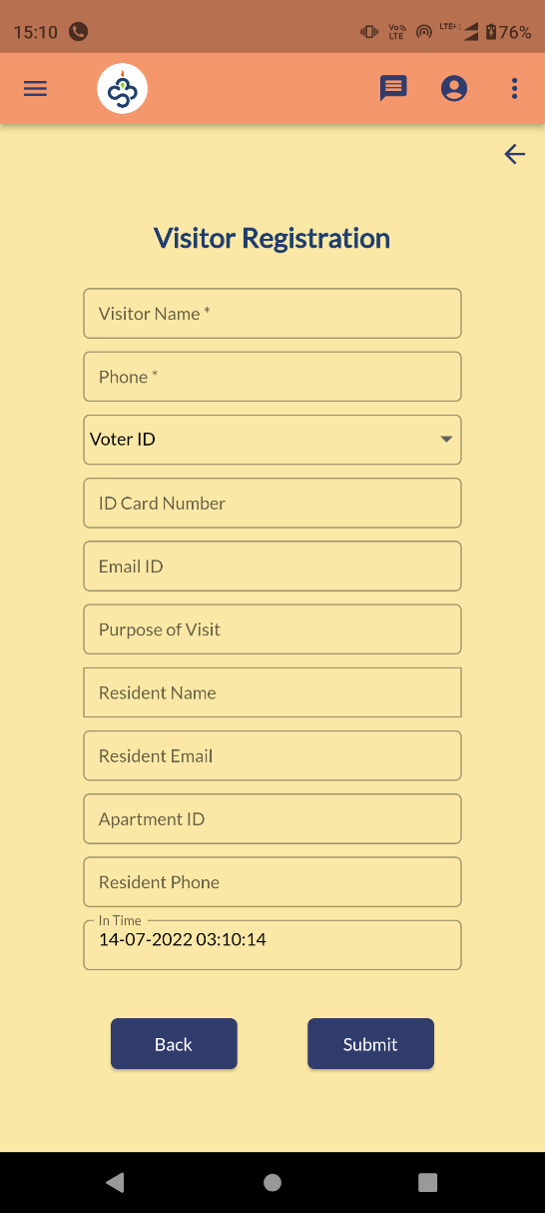
Visitor Registration

Slide 23
Visitor Management
Visitor >> Visitor Management
Admin/security can add a visitor/guest against a resident.
Scenario is as follows
Security adding a guest against you with your registered phone number in App.
You have to logged in to app as resident.
you will get a push notification titled Guest Notification.
Resident can go to visitor screen/ if app is in open state you will get a pop up message to approve visitor.

Slide 24
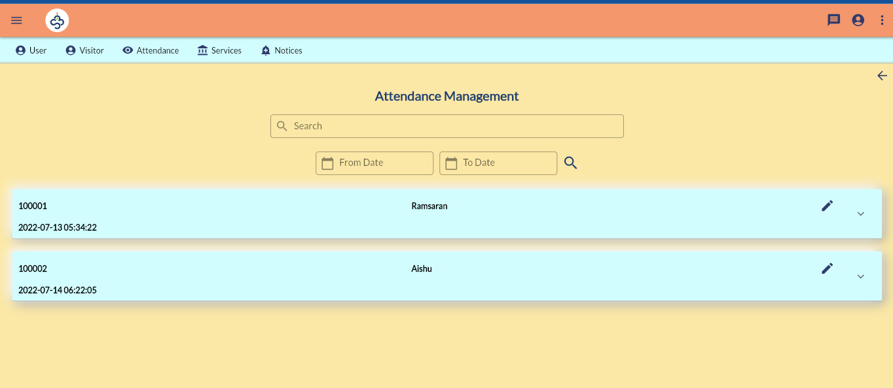
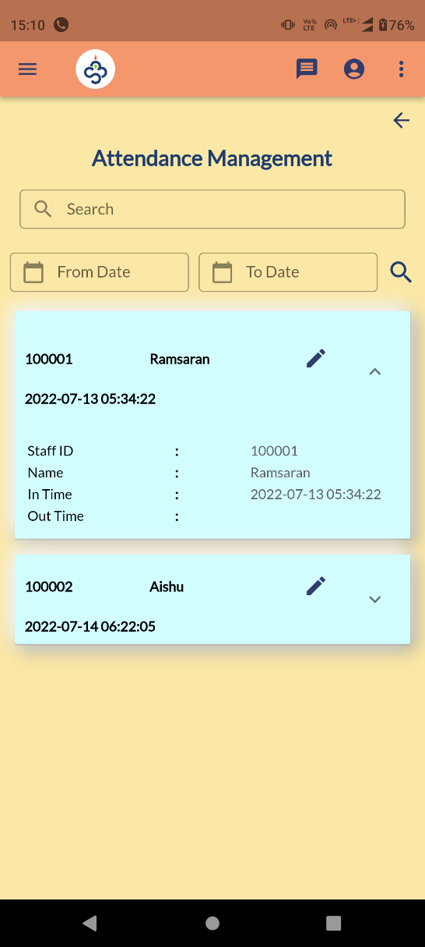
Attendance Management

Slide 25
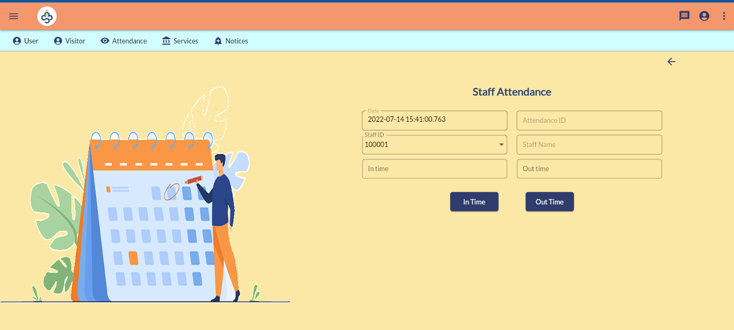
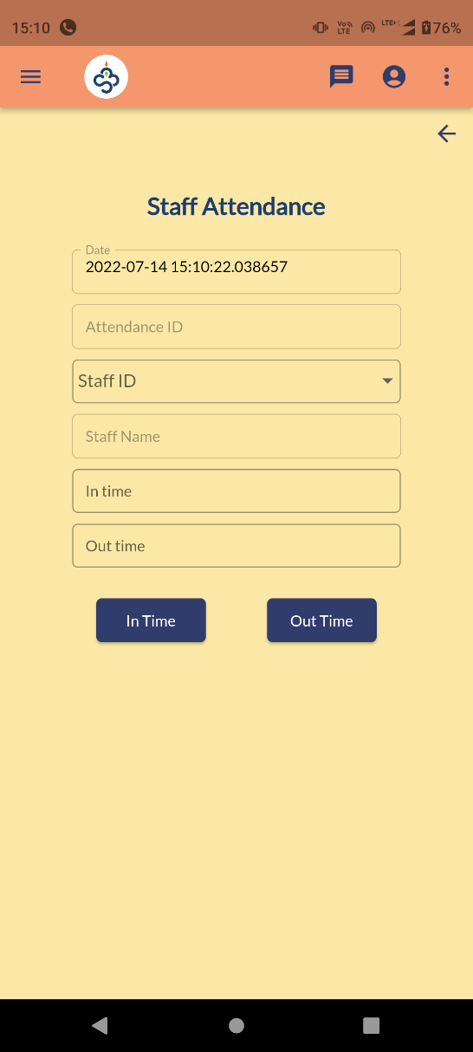
Staff Attendance

Slide 26
Attendance Management
Attendance >> Punch Attendance
Attendance can be marked against staffed.
Currently it is a manual process. Later it will be integrated with punching devices.
Attendance >> View Attendance
Use edit option to mark the out punch of a staff.

Slide 27
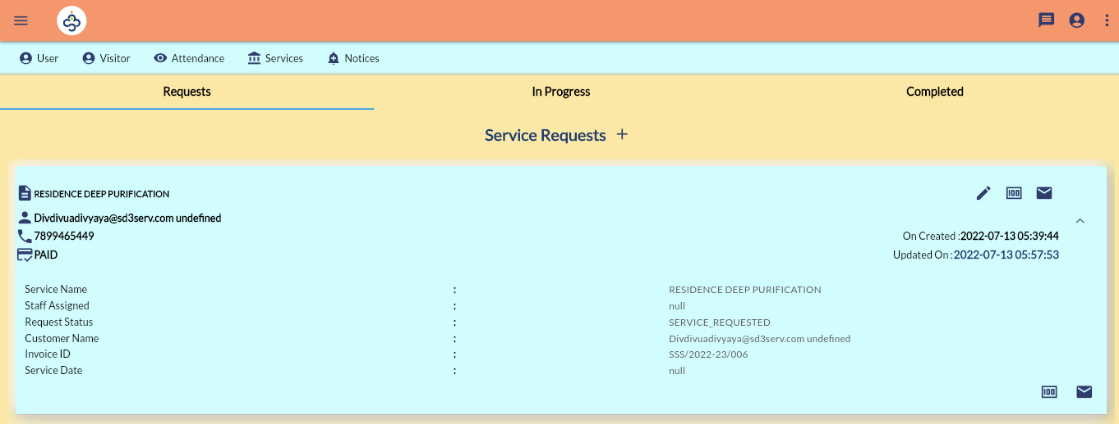
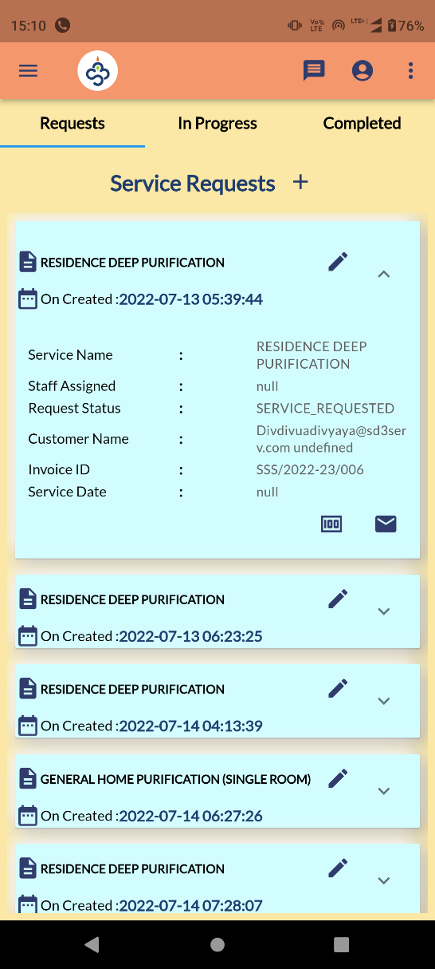
Service Request

Slide 28
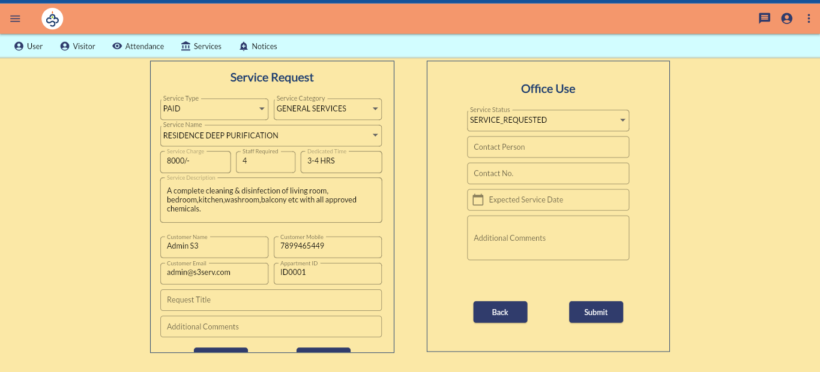
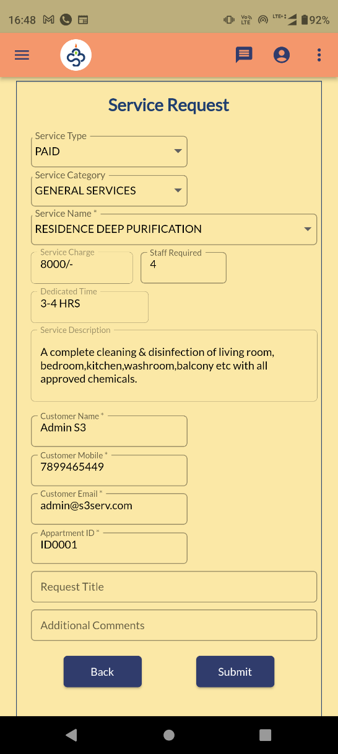
Service Request

Slide 29
Service Request
Services >> Service Requests
This is a page where resident can raise a complaint/service requests.
Admin raise requests on behalf of residents.
Resident can escalate the ticket to higher authority by clicking the email icon.
Admin can raise the invoice against the request by tapping the money icon.
Admin can only edit the request status.
Any change in service request status will be notified by toast message on login for user.

Slide 30
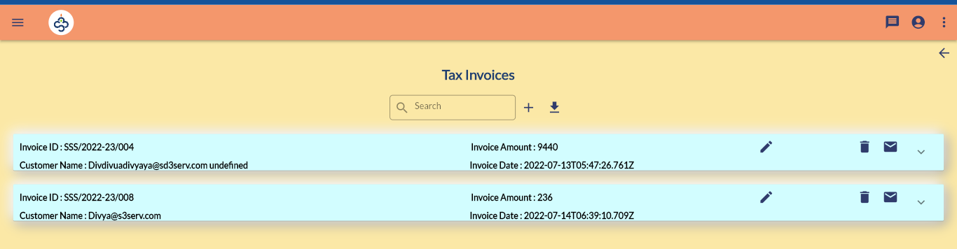
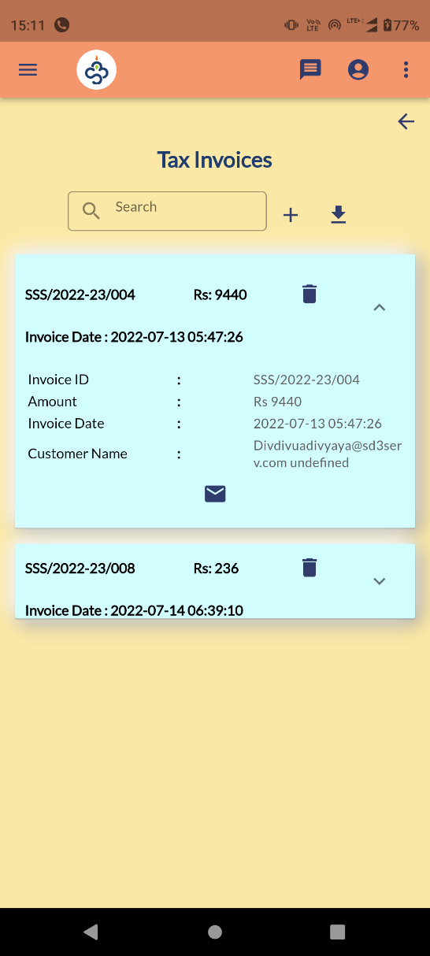
Invoice

Slide 31
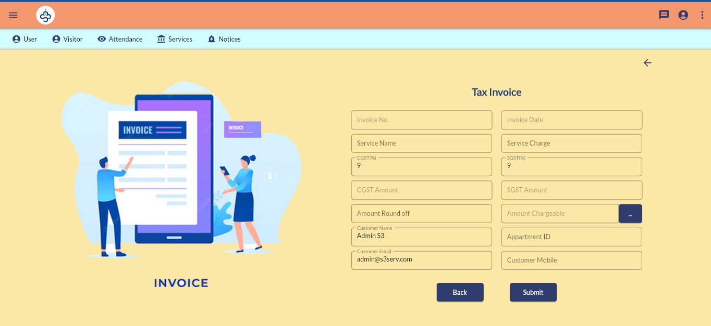
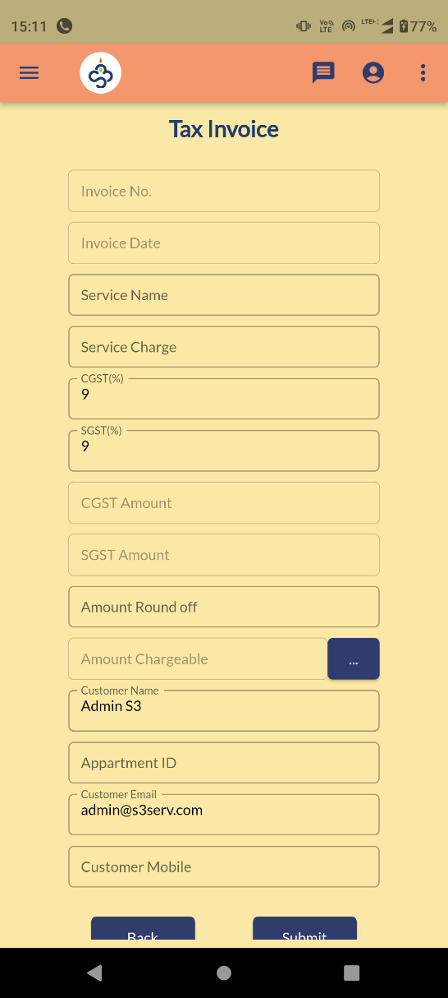
Invoice

Slide 32
Invoice Generation
Services >> Invoice Generation
An admin user can raise an invoice for miscellaneous purpose other than service request.
User email/phone should be proper so that resident can personally see the invoices generated against him.

Slide 33
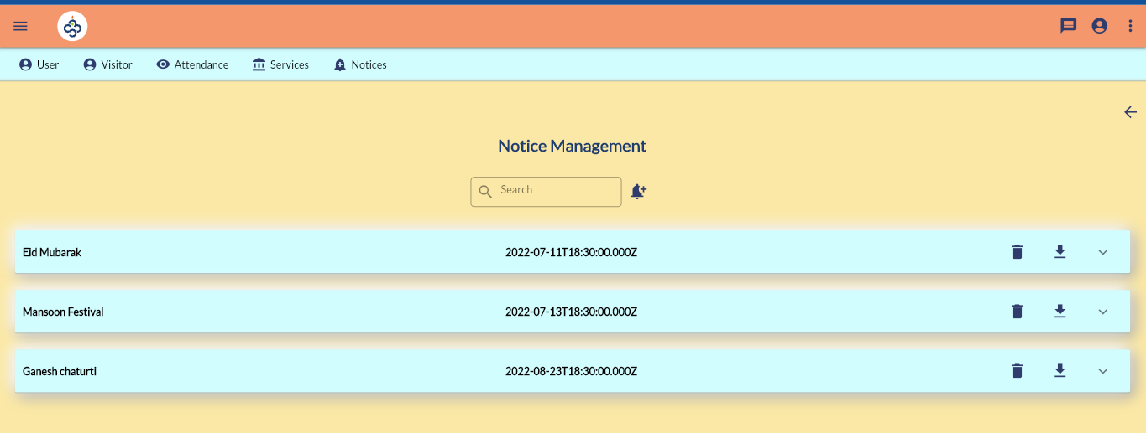
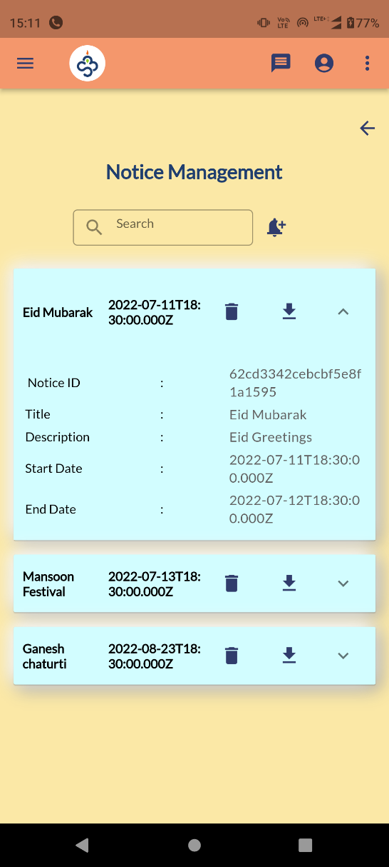
Notice Management

Slide 34
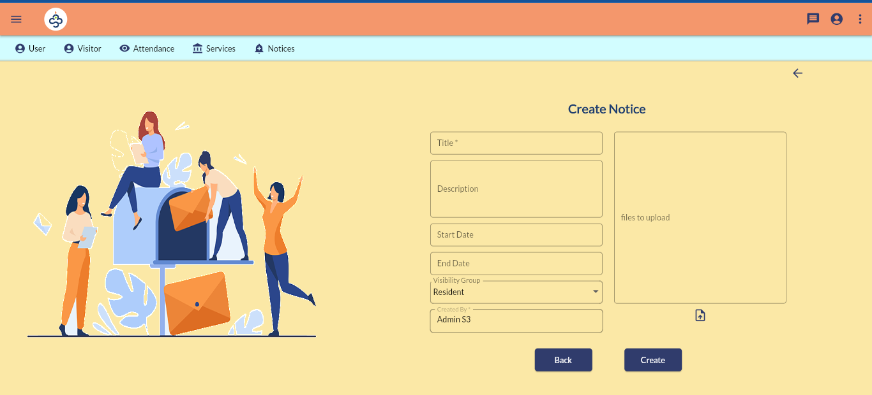
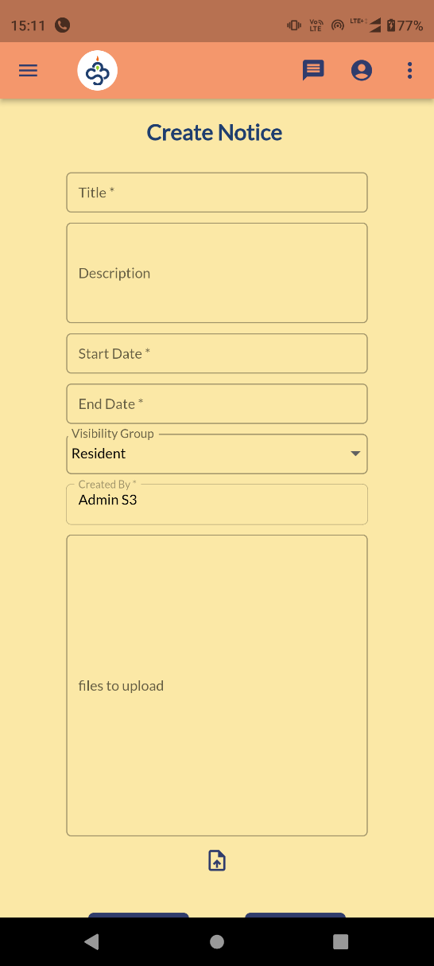
Create Notice

Slide 35
Notice Management
Notices >> Notice Management
An admin can create notifications/announcements for the registered users from here.
He can also provide related documents also.
Currently every registered user can see all notifications and can download docs attached if any.

Slide 36
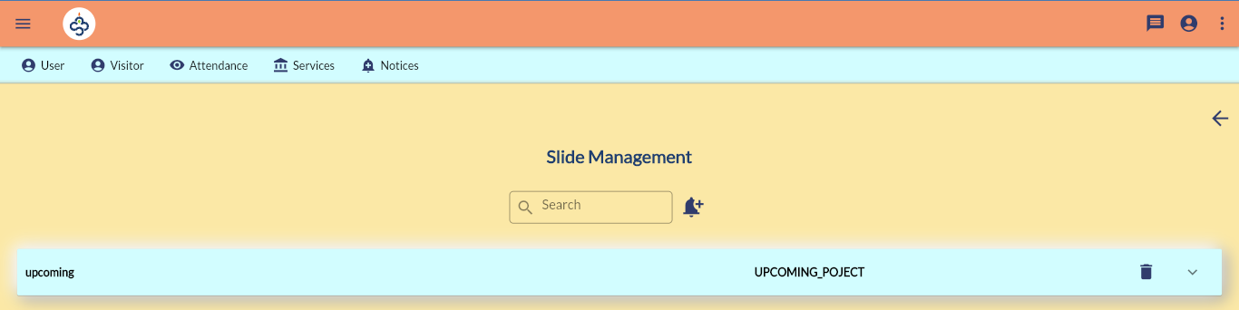
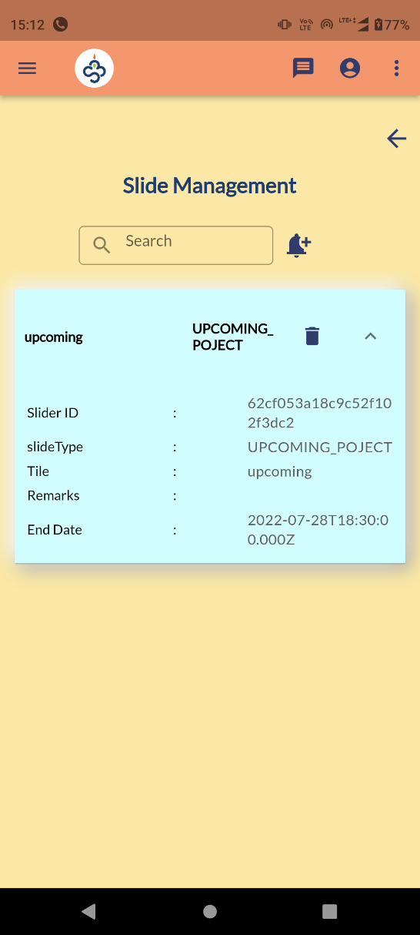
Slide Management

Slide 37
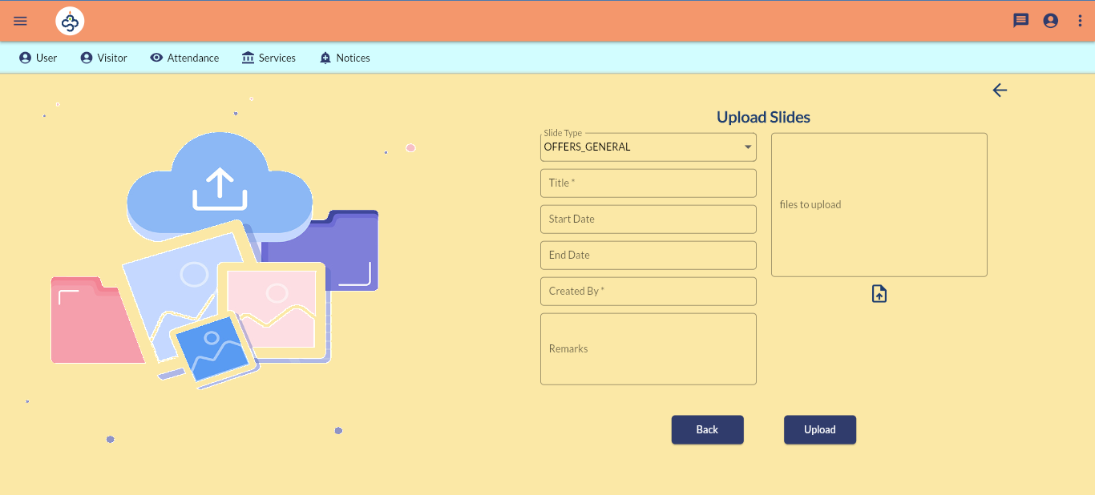
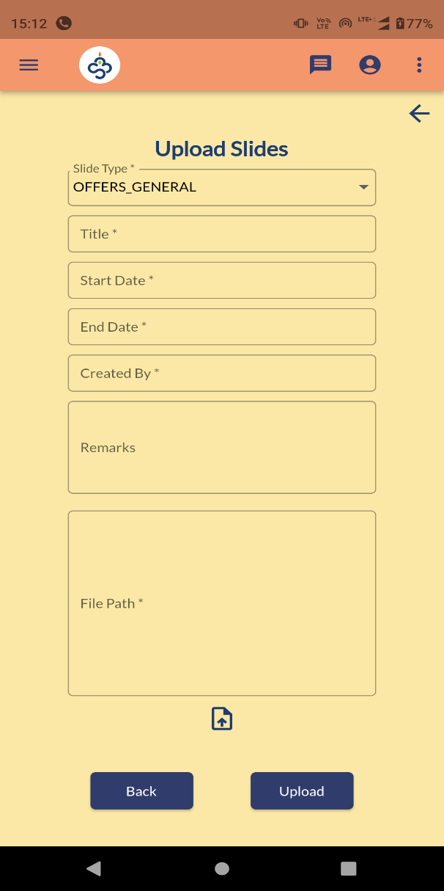
Slide Upload

Slide 38
Slide Management
Notices >> Upload Slides
Slide Management is an option to set offers, ads in the application
Currently it contains 4 types of options
OFFERS_GENERAL – to show any offer to general public and will be displayed in landing page of Web Application.
UPCOMING_PROJECT – Ads for upcoming projects
COMPLETED_PROJECT – Portfolio for completed ones.
OFFERS_USER - To provide offer for registered users and will be displayed in home page.

Slide 39


Contact us
Location #92, Ist Floor, Natraj building, Near SNS Arcade, Konnena , Old Airport Road, Bangalore 560017
+919380528940
www.nortcele.in

aks@nortcele.in

Slide 40
Thank You.

